Slide 1
Day 18
Linux Device Driver Training
Creating Analysis and Coverage Report
Presented by,
Ganavi M
Ganavigowda512@gmail.com

Slide 2
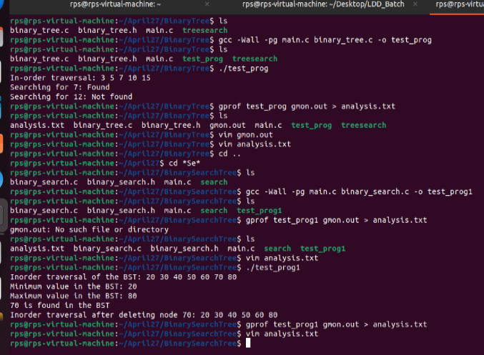
ANALYSIS REPORT

Slide 3
gcc: This is the GNU Compiler Collection, which is used to compile C code.
-Wall: This option enables "all" warnings during compilation. It helps the compiler catch common programming errors and questionable code constructs.
-pg: This option instructs the compiler to generate code for profiling. It adds instrumentation to the executable so that it can collect profiling data during execution.
main.c program.c: These are the source files that will be compiled into the executable.
-o test_proga: This option specifies the name of the output file (the executable). In this case, the executable will be named test_proga.
To execute the compiled program, you simply need to run the resulting executable file. In this case, the executable is named test_proga.
gprof: This is the GNU Profiler, a tool used to analyze the execution profile of a program. It collects profiling data during the execution of a program and generates a report that shows how much time is spent in each function, as well as how many times each function is called.
test_prog: This is the name of the executable program for which you want to generate the profiling analysis report.
gmon.out: This is the file that contains the profiling data collected during the execution of the program. The gmon.out file is generated when you run a program that has been compiled with the -pg flag, which enables profiling instrumentation.
> analysis.txt: This part of the command is used to redirect the output of the gprof command to a file named analysis.txt. The > symbol is used for output redirection, and it means that the output of the gprof command will be written to the file analysis.txt instead of being displayed on the terminal.
So, when you run the command gprof test_prog gmon.out > analysis.txt, gprof reads the profiling data from the gmon.out file generated during the execution of test_prog, analyzes it, and generates a profiling analysis report. The report is then saved to a file named analysis.txt. This report provides insights into the program's execution profile, including information about the time spent in each function and how the program's execution time is distributed among different parts of the code.

Slide 4
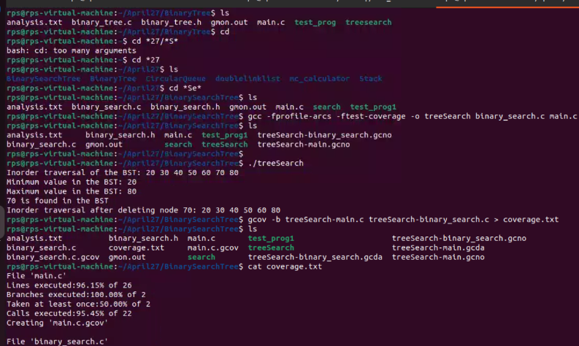
COVERAGE REPORT​

Slide 5
The command you provided compiles two C source files, binary_search.c and main.c, into an executable named treeSearch with coverage instrumentation enabled. Let's break down the command and its options:
gcc: This is the GNU Compiler Collection, used to compile C code.
-fprofile-arcs: This option instructs the compiler to generate code that records control flow information, such as which branches of conditional statements are taken during program execution. This information is used to measure code coverage during testing.
-ftest-coverage: This option enables coverage instrumentation, which generates additional code to track which parts of the program are executed during testing. It works in conjunction with -fprofile-arcs to collect coverage data.
-o treeSearch: This option specifies the name of the output file (the executable). In this case, the executable will be named treeSearch.
binary_search.c main.c: These are the source files that will be compiled into the executable. binary_search.c likely contains the implementation of a binary search algorithm, and main.c contains the main function or entry point of the program.
After compiling the code with coverage instrumentation enabled, you can execute the resulting treeSearch executable to run your program. During execution, coverage data will be collected. You can then use tools like gcov and gcovr to generate coverage reports and analyze the extent of code coverage achieved by your tests.

Slide 6
Thank you

